Slide 1
Quick Intro
Hiram Fleitas
Senior Customer Engineer
Microsoft Data & AI
aka.ms/hiram

Slide 2
About Me
Machine Learning
Synapse Analytics
Power Platform
DevOps
aka.ms/hiram

Slide 3

Hiram Fleitas
Who I Am:
Cuban and live in Miami since 93.
Wrote my first app at 13 and work with Computers since.
Recently, I’ve been laying tile at the home that I’m building for my family.
What I Do:
New Senior CE at Microsoft.
Worked on the SQL Big Data Cluster and ML Extension as an Early Adopter.
~25 years in Tech.
Analyze Me:
Father of 2, Ocean (5) and Skylar (3).
Resilient
Perseverance
Problem solver
Jar Opener
To Work With Me, You Should Know:
I speak English and Spanish.
You can reach me at any time.
I’m here to help.
The Last Word:
“Dad, you want to make something awesome with me. It shall be so crazy! LOL.”
“Believe in people.”
What I Like:
Construction
Breakfast with my kids
Watersports, wakesurf, wakeskate
Cuban coffee, hello!

Slide 4



















1995
1999
2000s
2017
2021

Slide 5
✔ Brand Awareness
✔ Fraud Detection - Customer Churn
✔ Ethics
✔ Sentiment
✔ QnA Chat Bots
✔ Forms
✔ Enterprise Capital Modeling - Financial Risk
✔ Length of Stay
✔ Object Detection

Slide 6
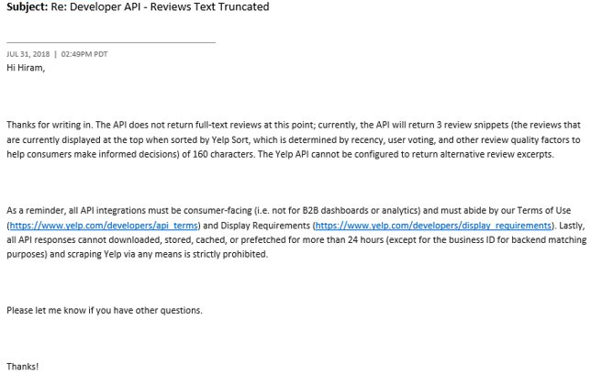
Learn more:
https://www.yelp.com/developers/api_terms
https://www.yelp.com/developers/display_requirements

Slide 7
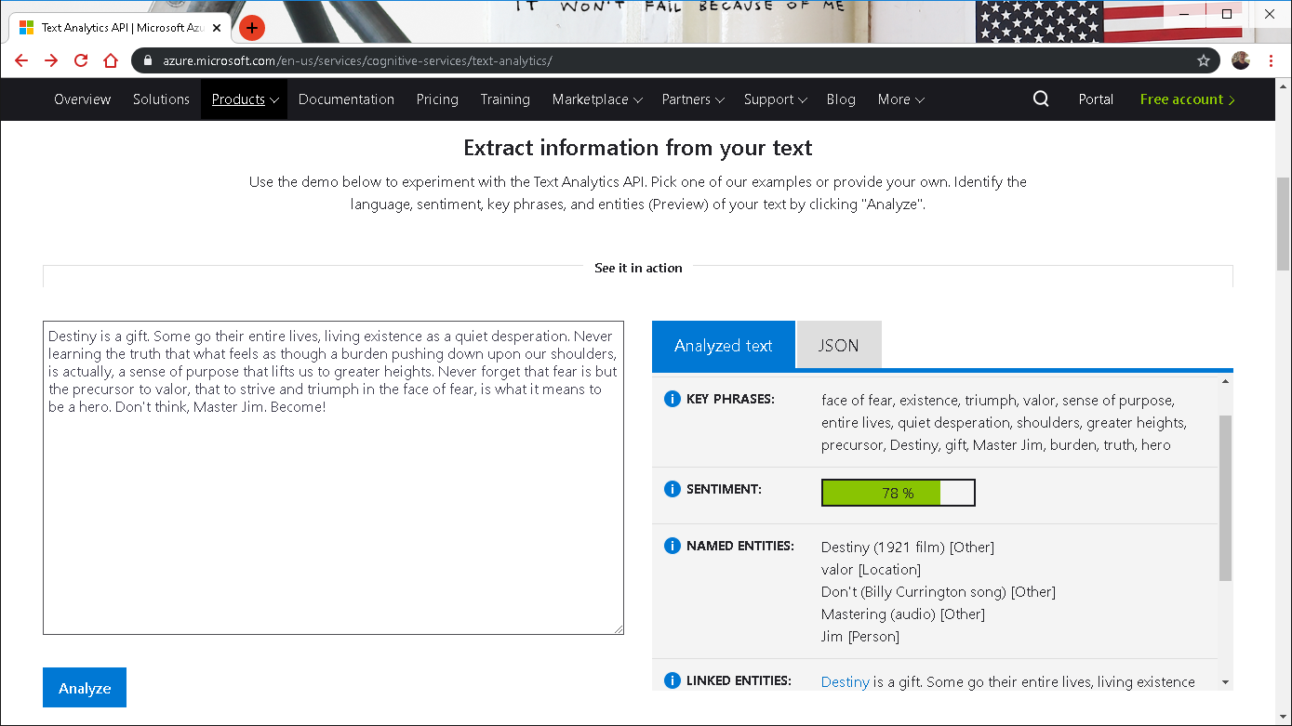

Notes:
https://www.netflix.com/title/80075820

Slide 8
create or alter proc GetCognitiveAPIQuoteSentiment
as
set nocount on;
declare @py nvarchar(max);
set @py = N'import requests, pprint as pr
from pandas.io.json import json_normalize
apikey = "mykey"
api = "https://eastus2.api.cognitive.microsoft.com/text/analytics/v2.0/"
url = api + "sentiment"
df = jsondocs
headers = {
"Ocp-Apim-Subscription-Key": apikey,
"content-type": "application/json"
}
response = requests.post(
sentiment_url,
headers = headers,
data = df.iloc[0][0].encode()
)
rds = response.json()
df2 = json_normalize(rds, "documents")
pr.pprint(rds)
print(type(df2),df2,sep="\n")
';
drop table if exists apiresults;
create table apiresults (id int, score float);
insert into apiresults
exec sp_execute_external_script @language = N'Python'
,@script = @py
,@input_data_1 = N'select * from JsonQuotes'
,@input_data_1_name = N'jsondocs'
,@output_data_1_name = N'df2'
select * from apiresults;
update q
set q.Sentiment = a.Score
from Quotes q
inner join apiresults a
on q.quoteid = a.id
where q.Sentiment is null;
go
Learn more:
github.com/hfleitas/seattle2019/blob/master/2SentimentPrediction/Trollhunters.ipynb

Slide 9
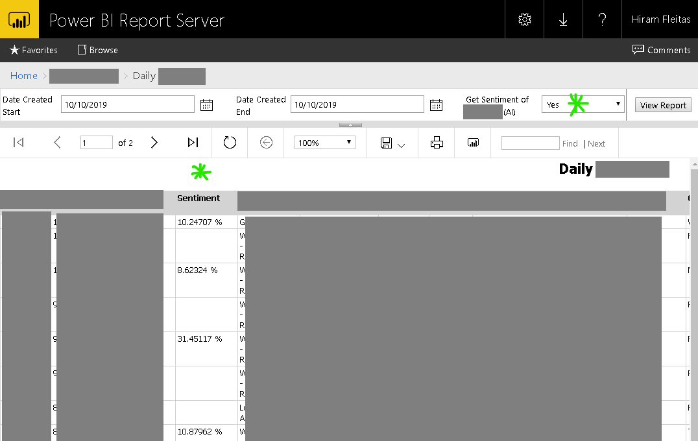
Learn more:
Hide Column based up Parameter Selected SSRS

Slide 10
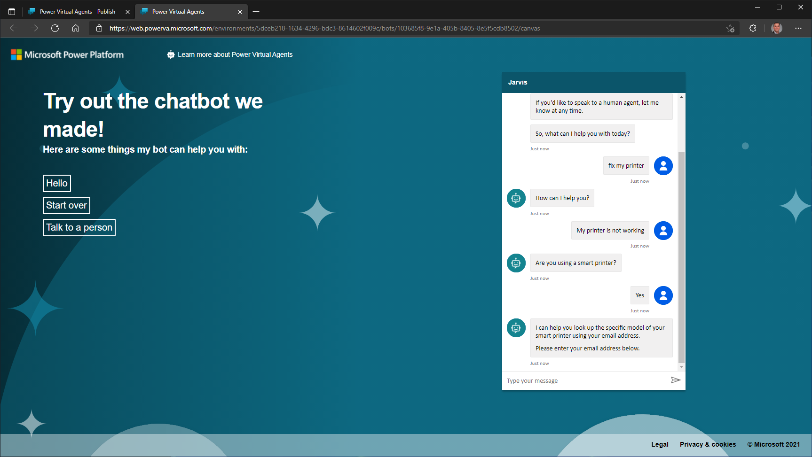
Notes:
https://www.netflix.com/title/80075820

Slide 11
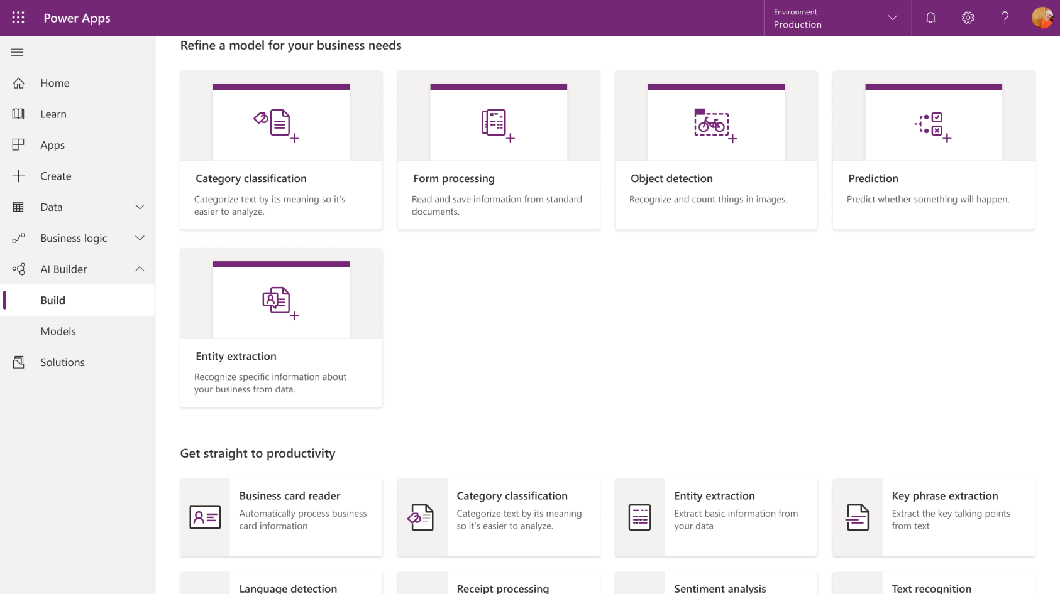

Slide 12
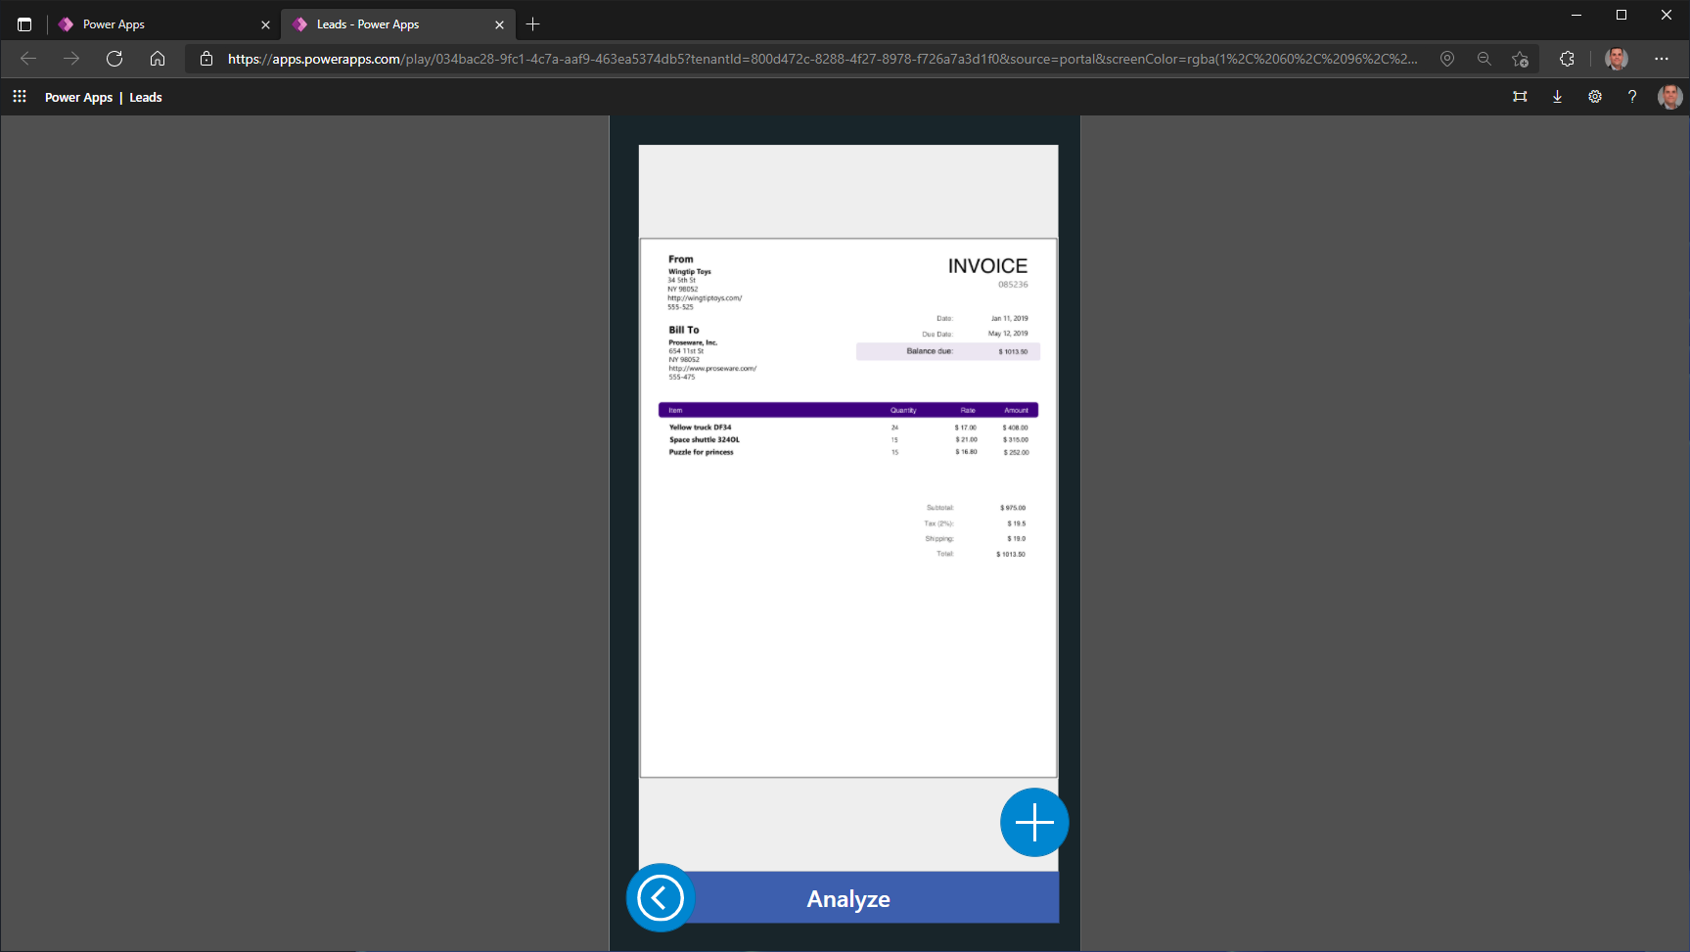

Slide 13
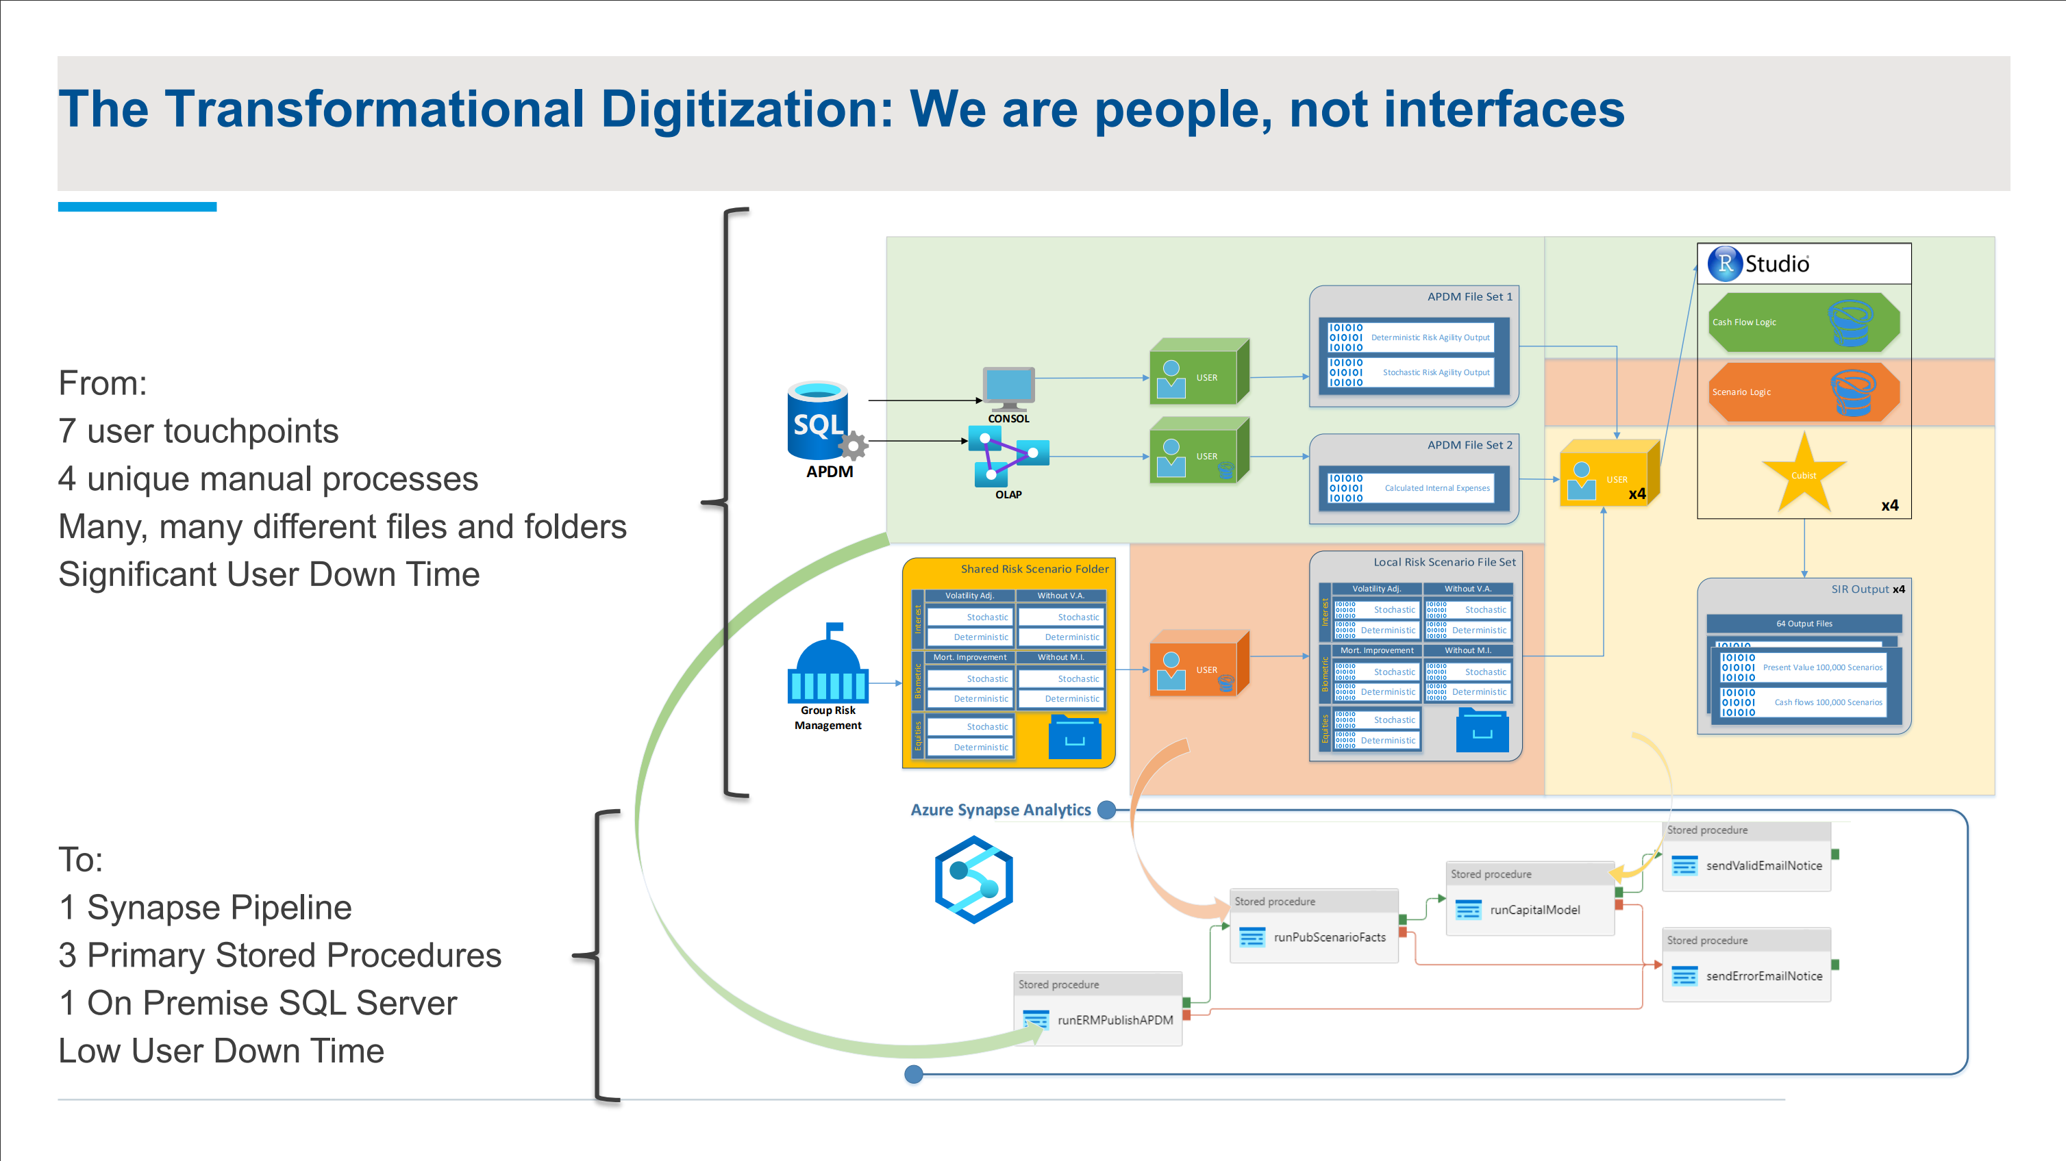
Notes:
https://www.netflix.com/title/80075820

Slide 14
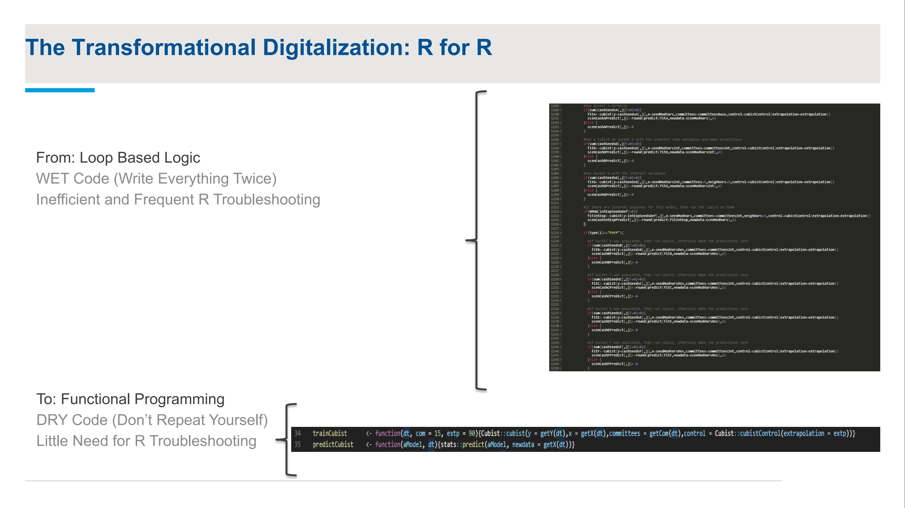
Notes:
https://www.netflix.com/title/80075820

Slide 15
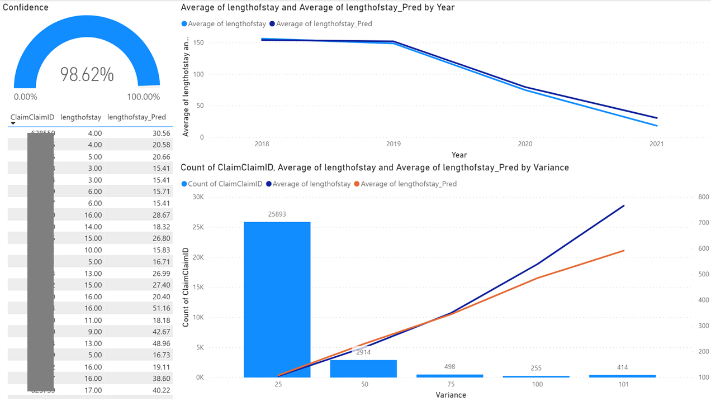

Slide 16
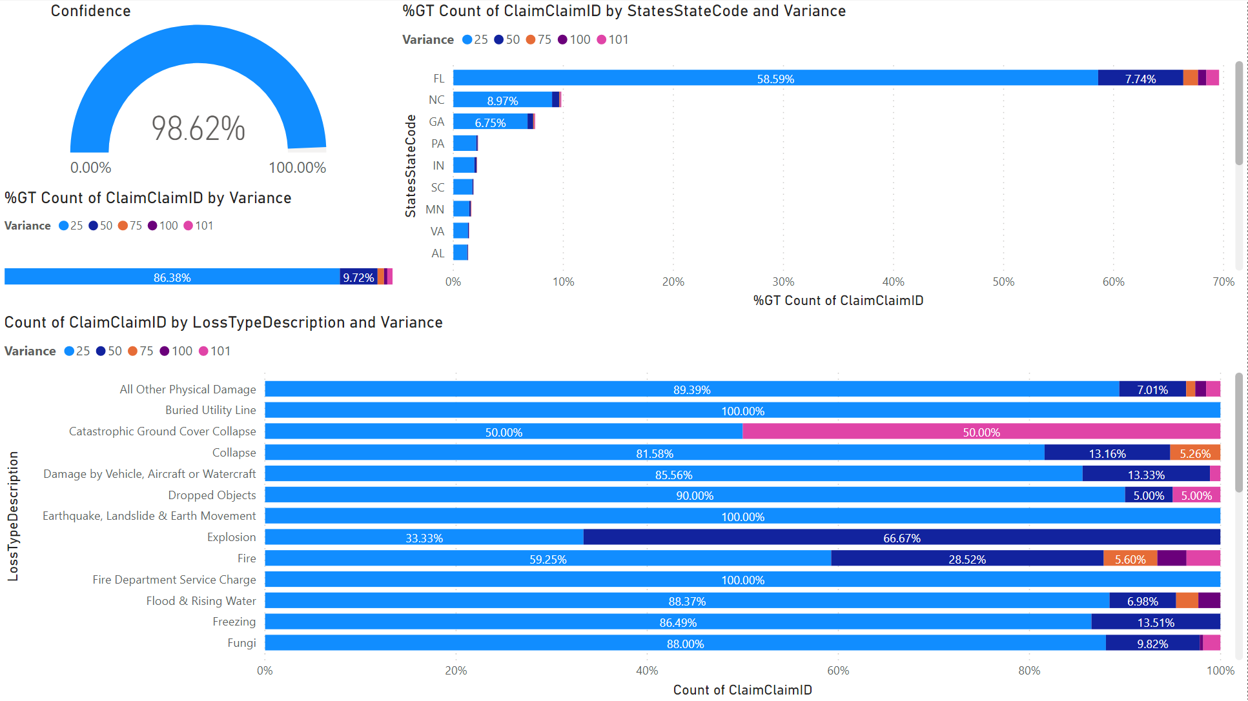

Slide 17
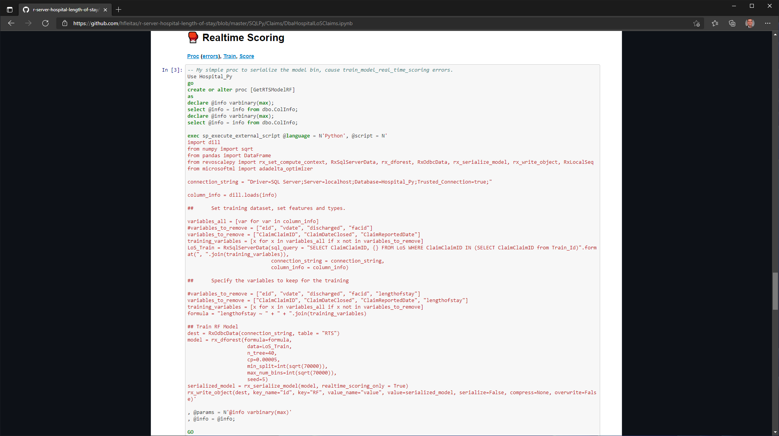


Slide 18
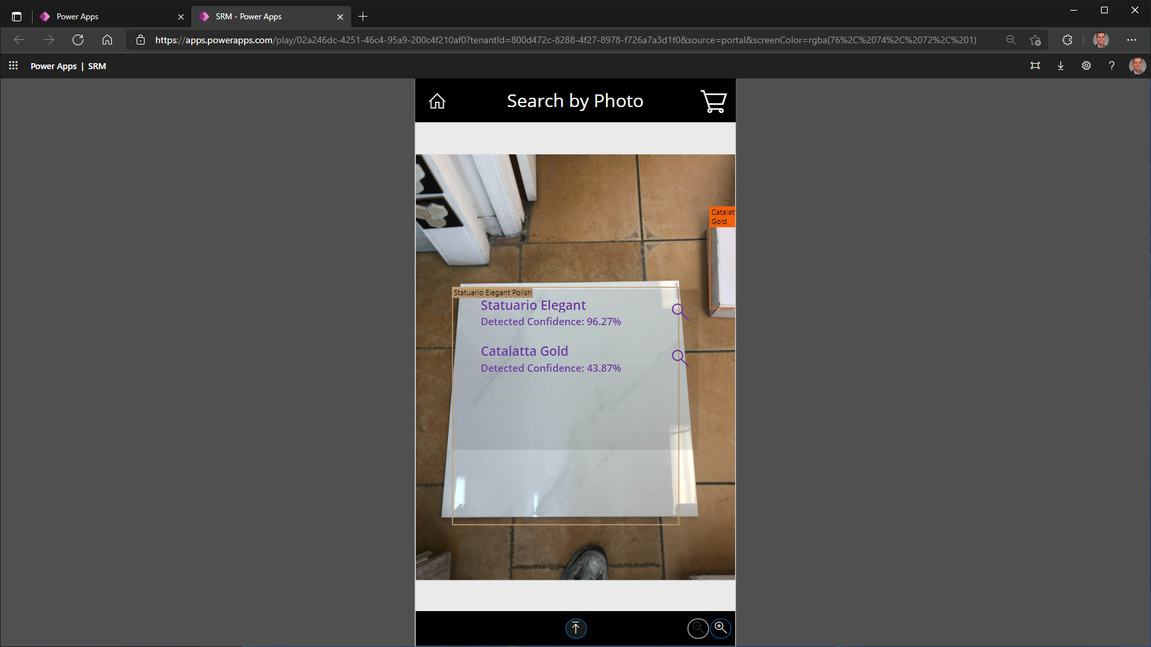

Slide 19














2017
2018
2019
2020
2021

Slide 20


Slide 21
Thank you
Hiram Fleitas
https://aka.ms/hiram

